Slide 1
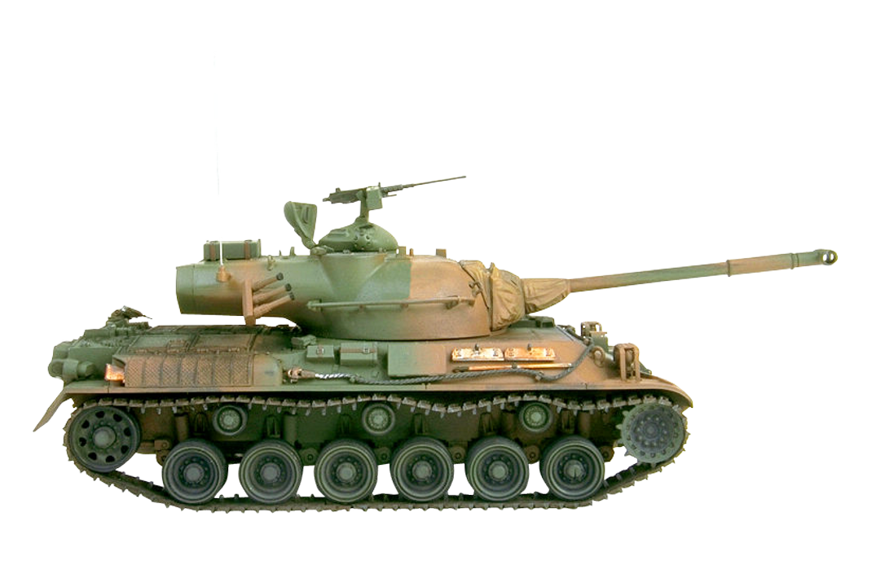
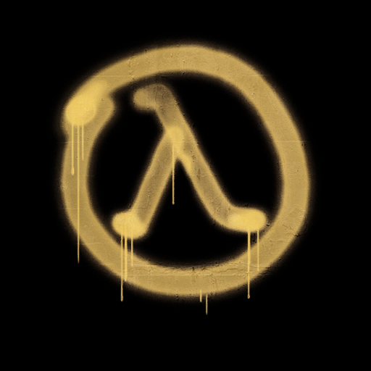
Racket Tanks
Jeremy joubert
Angel Zheondre Calcano

Slide 2
Mission Objectives
Classic top-down shooting game
Tanks vs tanks
Difficulty options
Enemy AI
Changing Levels

Slide 3
Mission Blueprint
Good guy class
Menu
Tank class
Bad guy class
Level
Game World

